Slide 1

UberElevate
ABES Engineering College, Ghaziabad, UP
Department of Information Technology
Project Presentation-1
Project Domain: Machine Learning
Project Group No: IT2023-24_P_
PROJECT GUIDE: Asst. Prof. Sahil Kumar Aggarwal
TEAM MEMBERS: Nistha Jain(2000320130102)
Pankhuri Baranwal(2000320130106)
Prachi Varshney(2000320130111)

Slide 2

Contents
Introduction
Requirements of Projects
Analysis of Problem-Based on Project Objective
Existing Work
Comparative Analysis of Existing Work
Requirement of the Project
Timeline of the Project
References

Slide 3

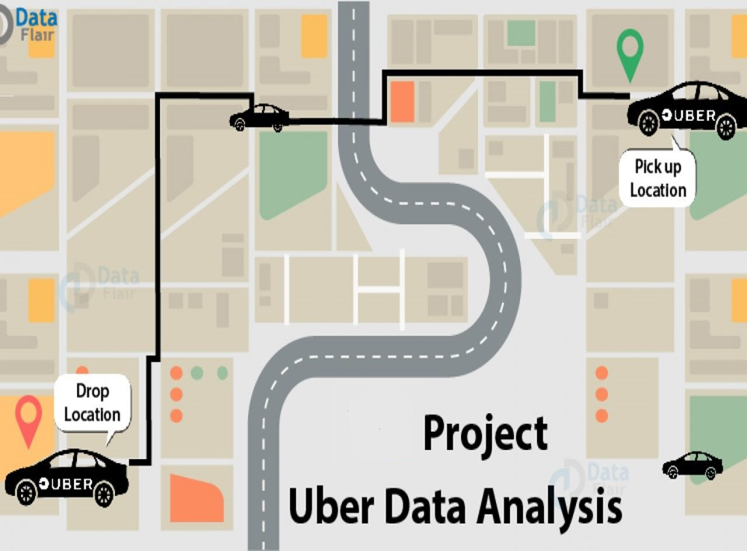


Slide 4

Introduction
In today's fast-paced urban environments, ridesharing services like Uber have revolutionized the way people move from one place to another. Uber, founded in 2009, has grown into a global transportation platform, connecting millions of riders with drivers in over 900 metropolitan areas worldwide. This widespread usage generates an immense volume of data that can be harnessed to improve the overall efficiency, safety, and user experience of the platform.
The objective of UberElevate is to explore and analyze Uber's data to derive actionable insights that can benefit both the company and its users.

Slide 5
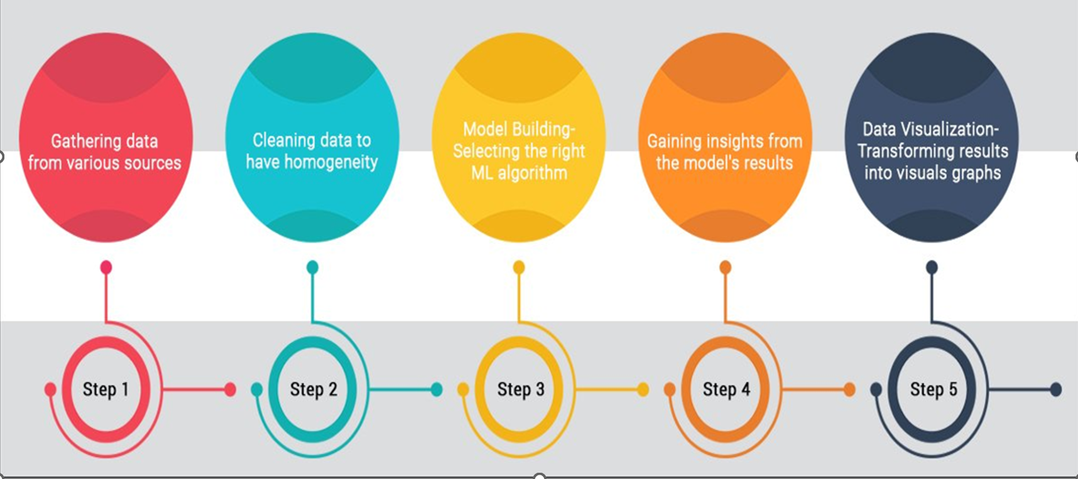
Requirements of Projects

Slide 6

Project Objectives
The objective of conducting a data analysis project on Uber's dataset is to extract valuable insights and actionable information from the vast amount of data generated by Uber's operations. This analysis aims to address several key objectives:
Optimizing Operations:Through data analysis, Uber can optimize driver allocation, reduce wait times for passengers, and enhance overall service quality.
Demand Forecasting:This helps in allocating drivers strategically during peak hours and in specific locations, ensuring better availability for users.
Price Optimization: Uber uses dynamic pricing, known as surge pricing, during high-demand periods.
Market Expansion: Data analysis helps in evaluating the potential for expansion into new markets, considering factors like population density, transportation infrastructure, and regulatory environment.

Slide 7

Analysis of Problem Based on Project Objective
1. Cab Type Selection:
Passengers often struggle to choose the most suitable cab type for their needs.
2. Optimal Booking Timing:
Passengers may not know the best times to book a ride for convenience and availability.
3. Cost-Effective Ride Selection:
Passengers seek cost-effective cab options but may not have enough information to compare fares.
4. Cab Availability Awareness:
Passengers often face challenges in finding available cabs during high-demand periods.
5. User-Friendly Data Access (Future Plan):
Analyzing data can be challenging for users who lack data analysis expertise.

Slide 8

Feature Engineering
All machine learning algorithms use some input data to create outputs. This input data comprise features, which are usually in the form of structured columns. Algorithms require features with some specific characteristics to work properly and so the need for feature engineering arises.
Feature engineering efforts mainly have two goals:
Preparing the proper input dataset, compatible with the machine learning algorithm requirements.
Improving the performance of machine learning models.

Slide 9
Features
Most Booked cab type:Passengers often struggle to choose the most suitable cab type for their needs.
Features used- cab_booked
Cost Effective Ride selection: Passengers may not know the best times to book a ride for convenience and availability.
Features used-key,fare_amount,pickup_date_time,passenger_count
Highest booking Time-
*by day
*by month
*by season
-Features used-date,month,year
Cab booking based on
*security
*availability
*cost effectiveness
-Features used-rating,time and price
InterCity and IntraCity supply analysis:Driver distribution in different areas
-Features used-Source location and destination location
Waiting time for cab: average duration between boked time and arrival time.
-Features used-booked time and arrival time

Slide 10

Comparative Analysis
Objective
Existing Project: Primarily focuses on business optimization and revenue generation.
Our Project: Prioritizes environmental sustainability and social responsibility.
Data and Techniques:
Existing Project: Relies on historical and real-time transactional data, machine learning for pricing optimization.
Our Project: Requires data on vehicle types, emissions, and environmental factors, and may involve policy analysis.
Impact:
Existing Project: Benefits Uber's profitability and user experience.
Our Project: Contributes to a greener and more sustainable future, aligning with societal and environmental goals.
Stakeholders:
Existing Project: Benefits riders, drivers, and Uber's bottom line.
Our Project: Benefits the environment, society, and riders concerned about sustainability.

Slide 11
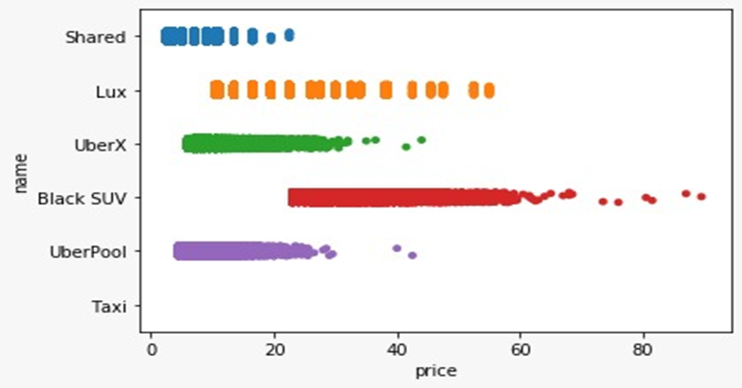
Project Model / Design

Slide 12

Conclusion and Future Plan
The project successfully analyzed Uber data, providing valuable insights into booking trends and cost-effectiveness.
Future plans include adding a Flask-based frontend, real-time data updates, predictive features, and user authentication for an improved user experience.

Slide 13
References
https://www.singlegrain.com/blog-posts/business/10-lessons-startups-can-learn-ubers-growth/
https://www.kaggle.com/brllrb/uber-and-lyft-dataset-boston
https://sci-hub.se/https://www.sciencedirect.com/science/article/abs/pii/S2210539517301165
https://ieeexplore.ieee.org/abstract/document/8260068
https://www.toppr.com/ask/question/what-are-the-limitations-of-a-scatter-diagram/
https://arxiv.org/abs/1503.03021
https://www.researchgate.net/publication/305524879_Dynamic_Pricing_in_a_Labor_Market_Surge_Pricing_and_Flexible_Work_on_the_Uber_Platform

Slide 14

Thank You !

